Slide 1

Creating Construction Connections
CareerStarter is a FREE career exploration tool designed to create connections. It provides resources to support individuals on their career journey from exploration to training to employment.
Notes:
CareerStarter is a FREE career exploration tool designed to create connections to the construction industry. It provides a wide range of resources to support individuals wherever they are on their career journey—from exploration to training to employment. [ENTER TO PLAY VIDEO]

Slide 2
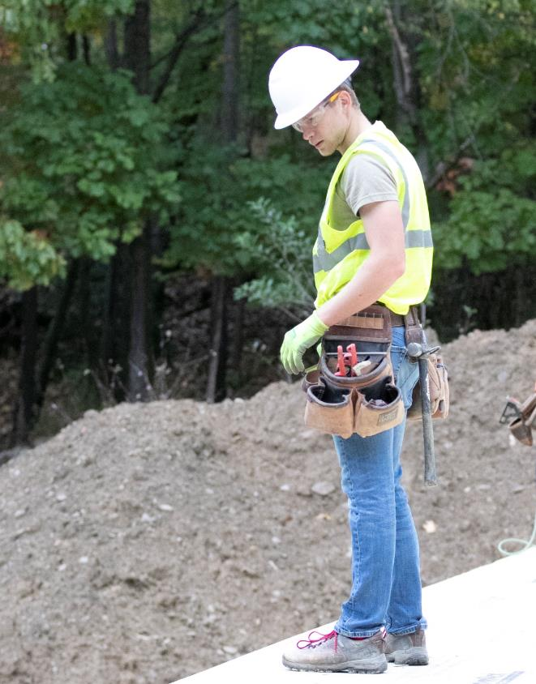
Kickstart Your Construction Career
CareerStarter can uncover a world of possibilities!
  Build your profile and export your resume in minutes.
  Connect with construction companies.
  Add skills, badges, and recommendations.
  Find training programs.
  Apply to jobs.
Notes:
Think you know construction? Construction is one of the most in-demand industries in the country. Offering high-paying jobs and limitless possibilities, you can design the future of your dreams.
You can play an important part, and how you do it is up to you!
Check out CareerStarter and uncover a world of possibilities open to everyone! [ENTER]
Build a profile and let CareerStarter create your resume in one click. [ENTER]
Connect with companies and explore the opportunities that construction has to offer. [ENTER]
Add skills, badges, and recommendations to your profile and stand out to employers. [ENTER]
Find training programs in your area. [ENTER]
Apply to jobs in less than two clicks. [ENTER FOR NEXT SLIDE]

Slide 3
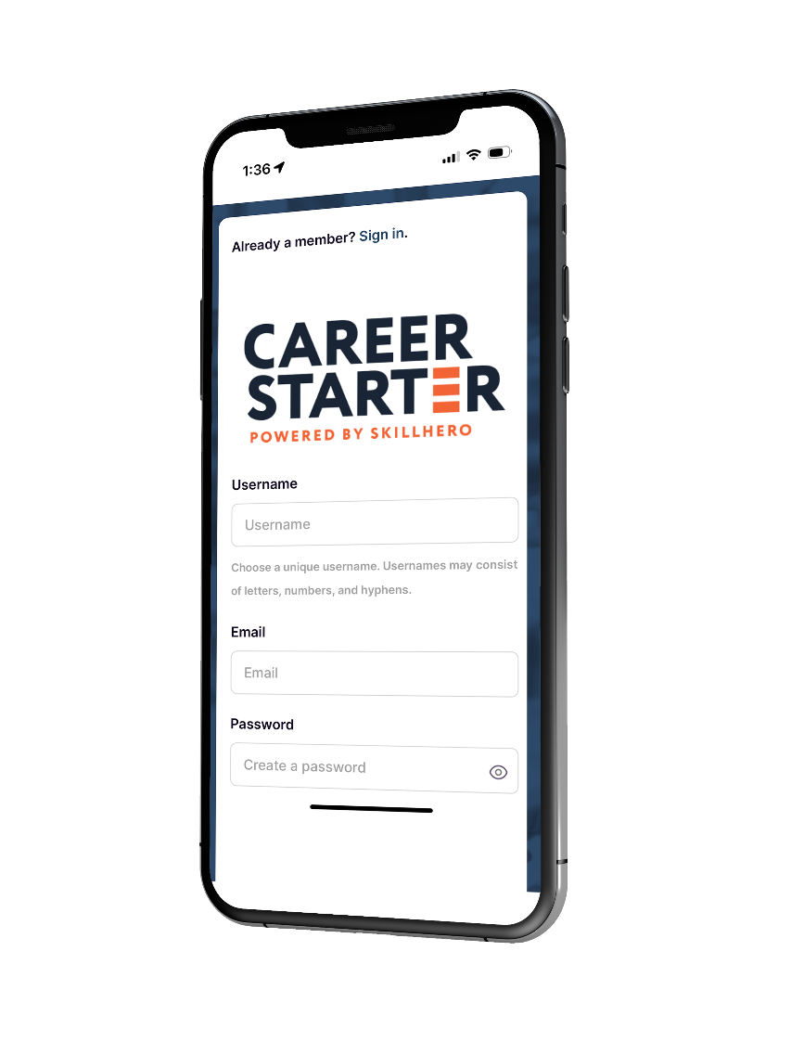
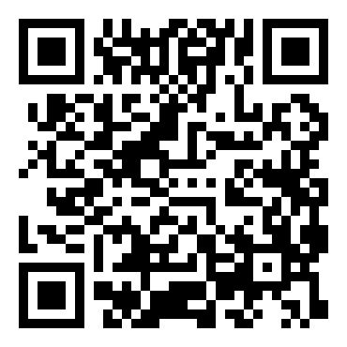


Get Started Today!
Visit CareerStarter at careerstarter.nccer.org, download the app, or scan the QR code below!
Notes:
Get Started Today!
It’s very easy to get started. Visit CareerStarter from your internet browser at careerstarter.nccer.org, download the app from your preferred app store, or scan the QR code on the slide.

